Slide 1



CS 310 : Scalable Software Architectures
Class session on Thursday, October 3rd
Notes:
Focus this week:
Relational databases
Class sessions *are* being recorded this week
Will be available under Panopto on Canvas
Project 01 due next Wednesday @ 11:59pm
Build a simple photo app using AWS
Parts 01 and 02 are both released
Can submit as late as Friday @ 11:59pm
Office hours started Monday
Optional SQL homework posted

Slide 2
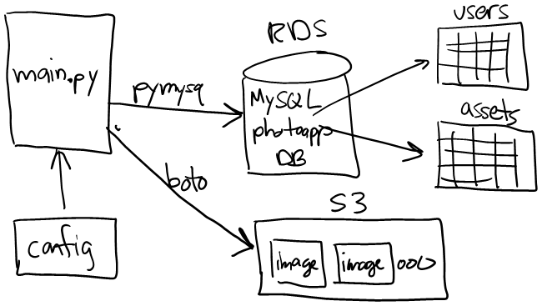
Project 01

Slide 3
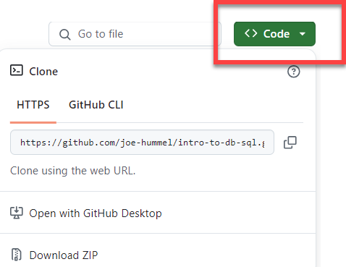
Goals for today
Executing SQL from Python
With sqlite3, a local file-based DBMS
With MySQL running on a server in AWS
Work with Docker
Docker Desktop must be installed
Download files from GitHub:
https://github.com/joe-hummel/intro-to-db-sql
Clone repo or download ZIP
Same files as Tuesday, no need to clone/download again

Slide 4
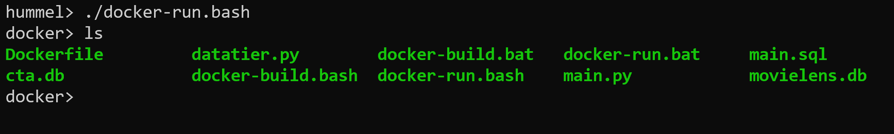
Getting the necessary software
Download files you need for today
https://github.com/joe-hummel/intro-to-db-sql
Clone repo or download ZIP
Make sure Docker Desktop is running
Build Docker image and run container:
Linux/Mac/Windows WSL:
Open terminal, navigate to repo folder
chmod 755 *.bash
./docker-build.bash
./docker-run.bash
Windows:
Open Powershell, navigate to repo folder
.\docker-build.bat
.\docker-run.bat

Slide 5
Common docker errors
"docker" command not found
Uninstall and reinstall Docker Desktop
When you try to build, you are not authorized
docker login -u docker-username
When you try to run, you get errors like "bash: $\r: command not found"
If you see the docker> prompt, type exit
((Get-Content .bashrc) -join "`n") + "`n" | Set-Content -NoNewLine .bashrc

Slide 6
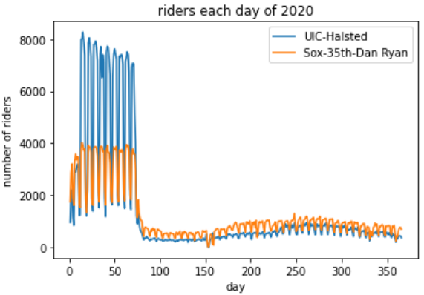
Executing SQL within other languages
SQL is a powerful language, but lacking in other areas
No UI support, no graphics, no web, no mobile
SQL is commonly embedded within other languages
JavaScript
Python
Java
Swift
C#
etc.

Slide 7

Executing SQL from Python
Database server
SELECT * FROM ...;
Database

Slide 8
sqlite3 Python library
import sqlite3
dbConn = sqlite3.connect("filename.db")
dbCursor = dbConn.cursor()
# query to retrieve 1 row from DB:
sql = """
Select …
From …
Where … ;
"""
dbCursor.execute(sql)
row = dbCursor.fetchone()
print(row)
Open connection
Create a cursor
Execute SQL
Fetch result
fetchone( )
Returns a tuple (...)
fetchall( )
Returns a list of tuples
# query to retrieve N values from DB:
sql = """
Select …
From …
Where … ;
"""
dbCursor.execute(sql)
rows = dbCursor.fetchall()
for row in rows:
print(row)

Slide 9
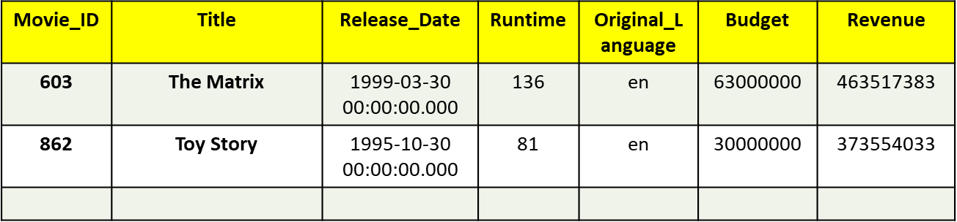
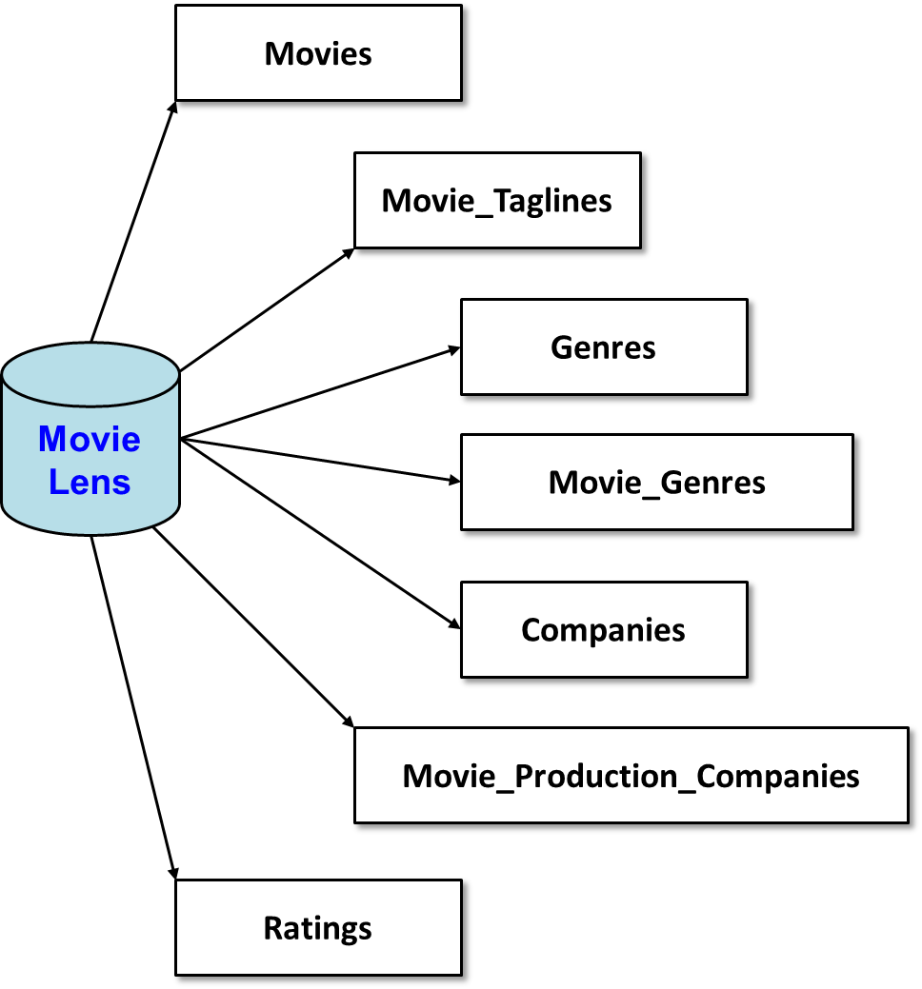
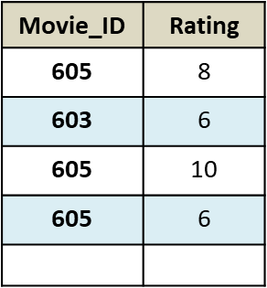
MovieLens database

Slide 10
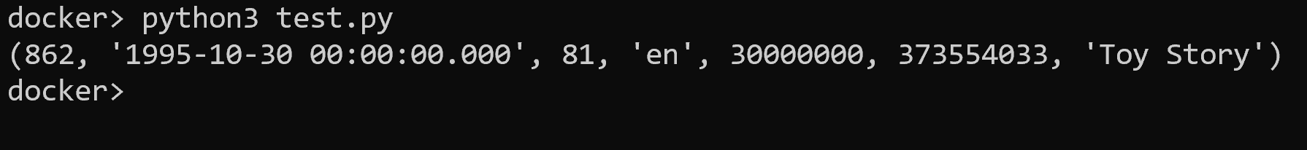
Exercise #1
Build docker image (if you haven't already)
Run docker image
Create a file in the repo folder named "test.py"
Open "test.py" in your favorite text editor
Code in Python
Open MovieLens.db
Retrieve all columns for 'Toy Story'
Print the row
Docker> python3 test.py
import sqlite3
dbConn = sqlite3.connect("movielens.db")
dbCursor = dbConn.cursor()
sql = """
select * from movies
where title = 'Toy Story';
"""
dbCursor.execute(sql)
row = dbCursor.fetchone()
print(row)

Slide 11
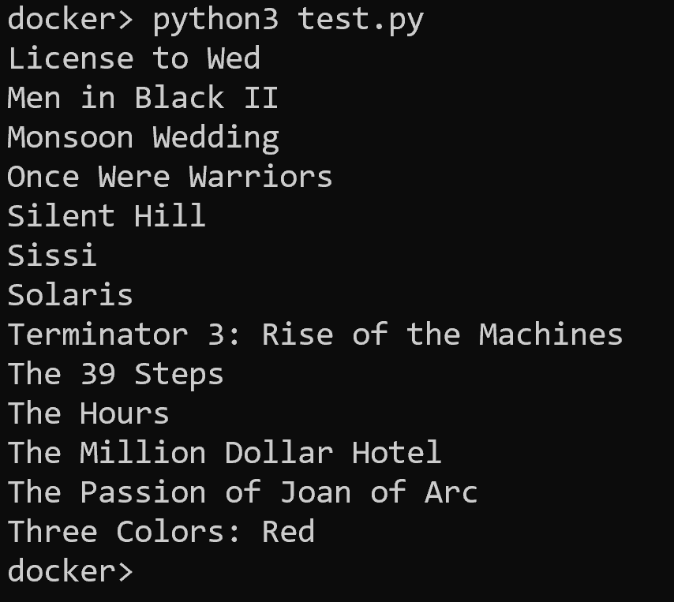
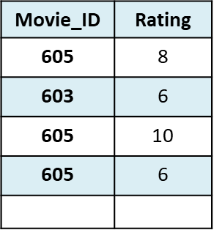
Your turn
Output all movies that have > 200 reviews
You need a join, group by, and having
Use fetchall( )
Movies
Ratings
Notes:
sql = """
select title
from movies
join ratings on ratings.movie_id = movies.movie_id
group by movies.movie_id
having count(rating) > 200
order by title;
"""
dbCursor.execute(sql)
rows = dbCursor.fetchall()
for row in rows:
print(row[0])

Slide 12
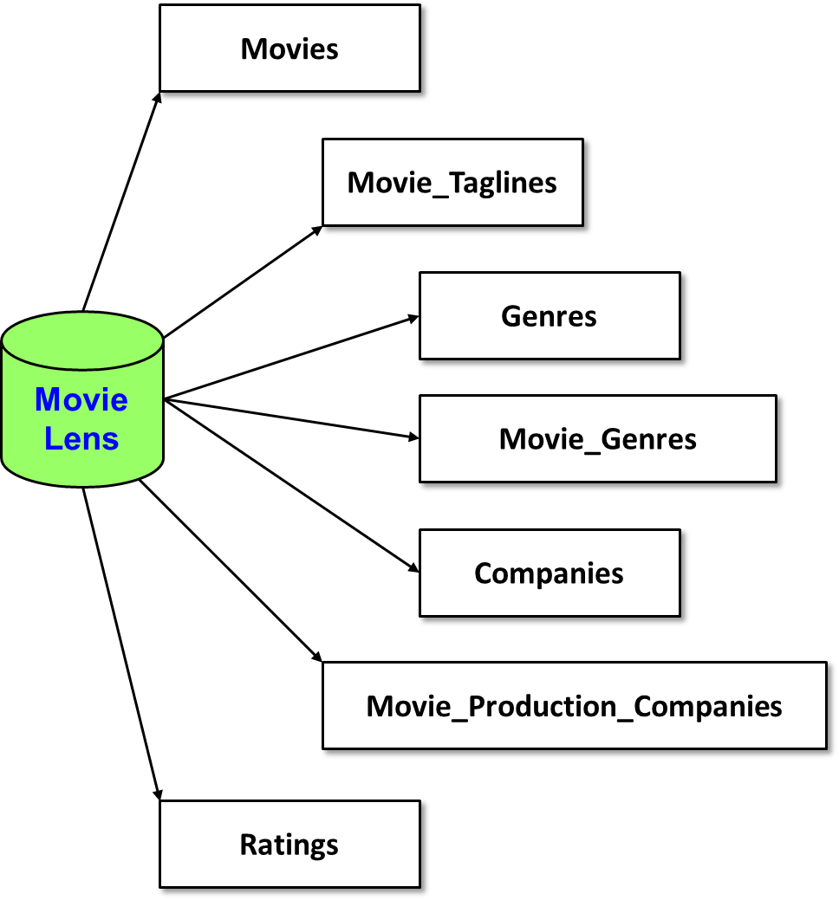
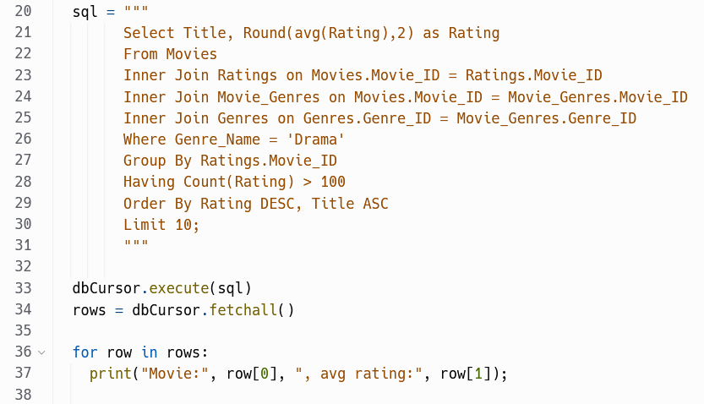
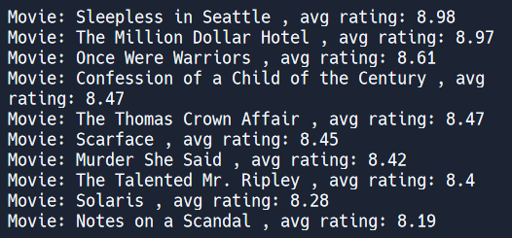
Top-10 movies in Drama genre
Top-10 Drama movies

Slide 13
Execute the query
The code is already provided in "main.py"
Docker> python3 main.py

Slide 14
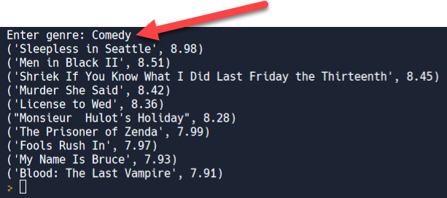
Parameterized (“dynamic”) queries
Most queries are dynamic, responding to user input

Slide 15
Executing dynamic queries
import sqlite3
dbConn = sqlite3.connect("chicago-police-stops.db")
dbCursor = dbConn.cursor()
genre = input("Enter genre: ")
sql = """
Select Title, Round(avg(Rating),2) as Rating
From Movies
Inner Join Ratings on Movies.Movie_ID = Ratings.Movie_ID
Inner Join Movie_Genres on Movies.Movie_ID = Movie_Genres.Movie_ID
Inner Join Genres on Genres.Genre_ID = Movie_Genres.Genre_ID
Where Genre_Name = ?
Group By Movies.Movie_ID
Having Count(Rating) > 100
Order By Rating DESC, Title ASC
Limit 10;
"""
dbCursor.execute(sql, [genre])
rows = dbCursor.fetchall()
for row in rows:
print(row)
placeholder…
NOTE: with MySQL use %s instead of ?
Provide parameter value(s) in call so DBMS builds query and checks for injection attacks

Slide 16
Try it
Modify "main.py" in your favorite editor
Modify SQL query string, replacing 'Drama' with ?
Pass genre value in call to execute( sql, [genre] )
Run and try different genres (Comedy, Horror, …)
Docker> python3 main.py

Slide 17

Beware SQL injection attacks
genre = input("Enter genre: ")
sql = "…" + genre + "…"
sql = f"… {genre} …"
dbCursor.execute(sql)
rows = dbCursor.fetchall()
for row in rows:
print(row)
NEVER build sql query strings yourself --- you open the door to SQL injection attacks
https://www.bleepingcomputer.com/news/security/researchers-find-sql-injection-to-bypass-airport-tsa-security-checks/
Notes:
Demo with main-concat.py and enter this input
ignore'; delete from ratings; --

Slide 18


How about executing SQL with MySQL?
Database server
SELECT * FROM ...;
Database

Slide 19
pymysql
Use pymysql module --- nearly identical API !
https://pymysql.readthedocs.io/en/latest/
import pymysql
try:
dbconn = pymysql.connect(
host=ENDPOINT,
port=PORTNUM,
user=USERNAME,
passwd=PASSWORD,
database=DBNAME)
sql = "…"
dbCursor = dbconn.cursor()
dbCursor.execute(sql)
rows = dbCursor.fetchall() # or fetchone()
for row in rows:
print(row)
except Exception as e:
print("Database connection failed due to {}".format(e))
For dynamic queries use %s instead of ?

Slide 20
Try it
Modify "Dockerfile" in your favorite editor
On the last line add: RUN pip3 install pymysql
Exit your docker container: exit
Build docker image
Run docker image
Download "main-mysql.py"
https://tinyurl.com/main-mysql
Move "main-mysql.py" into your repo folder
Docker> python3 main-mysql.py
Try it with these genres:
Music
Family
Horror

Slide 21
That's it, thank you!

Slide 22
Movies
Movie_Taglines
Genres
Movie Lens
Movie_Genres
Companies
Movie_Production_Companies
Ratings

Slide 23
Movie_ID | Title | Release_Date | Runtime | Original_Language | Budget | Revenue
603 | The Matrix | 1999-03-30 00:00:00.000 | 136 | en | 63000000 | 463517383
862 | Toy Story | 1995-10-30 00:00:00.000 | 81 | en | 30000000 | 373554033
Movies
Movie_ID | Tagline
603 | Welcome to the Real World.
605 | Everything that has a beginning has an end.
Movie_Taglines
Movie Lens
Ratings
Movie_ID | Rating
605 | 8
603 | 6
605 | 10
605 | 6

Slide 24
Company_ID | Company_Name
1885 | Silver Pictures
6194 | Warner Bros.
Movie_ID | Company_ID
603 | 1885
603 | 6194
862 | 3
Companies
Movie_Production_Companies
Movie_ID | Genre_ID
862 | 16
862 | 35
603 | 28
603 | 878
Movie Lens
Movie_Genres
Genres
Genre_ID | Genre_Name
28 | Action
878 | Science Fiction
16 | Animation
35 | Comedy

